Slide 1
Creating Investigations for VCE Maths Methods
James Mott – Southern Cross Grammar jmott493@gmail.com
Chris Ireson – Melbourne High School ireson.cj@gmail.com

Slide 2
Learning Intention
To learn strategies to help create a Mathematical Investigation, and to understand how CAS technology can support with Investigation
Format of workshop:
Information on Investigations
Using CAS
Having a go at a sample Investigation

Slide 3
Strategies for creating structured investigation
Think of a ‘big idea’ and see how you can break it down into the three components:
1. specific/familiar cases,
2. exploring/generalising,
3. exploring the same idea/theme, just with something a bit different
In drafting such a task, start with the general case and work backwards to get an overview, then work forwards with the specific cases
Don’t try to incorporate every skill. Not the point. You should be assessing these in your classroom with regular formative assessment.
There’s the structure of the task

Slide 4
Strategies for creating open-ended questions
Turn the question around
Give students the answer/conditions and ask them to create something from that
Write a polynomial that has the roots of 3 &-4
One side of a right triangle is 5 units long. What could the other side lengths be?
Ask for similarities and differences
Students comment/describe what they observe/calculate
Students develop their own conclusions/conjectures
Allow students to choose their own values and techniques
Select different values for the parameters in $y=axe^{−bx}$ and observe how the values affect the features of the graph.
Students choose their own method of working through a problem

Slide 5
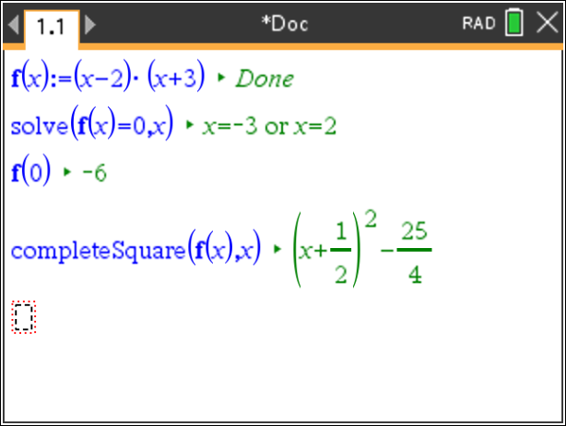
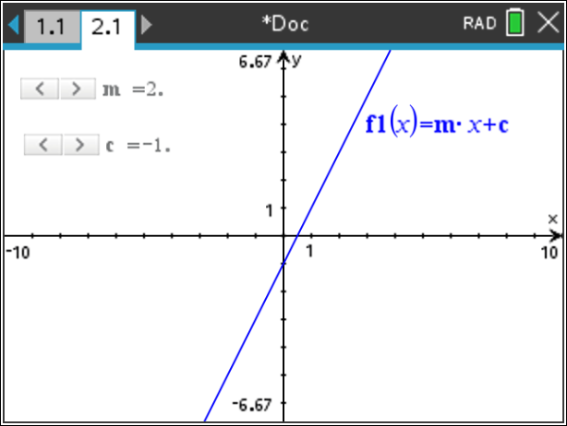
Tips for using CAS technology to aid Investigation
Students can use the dynamic environment of CAS technology to enhance their understanding through visualisation, which can aid them in progressing to conjecturing and generalising.
Utilizing dynamic environment of the Notes Application to perform algebraic operations and computations.
Using sliders in a graphs page to visualise and explore effects of parameters.
Best to ‘minimise’ the slider to allow for easier use. On the handheld, hover over the slider and press
(for a right-click) and press minimise.

Slide 6
Have a go at investigating with the TI-Nspire Put yourselves in the students’ shoes
Choose the component you would like to explore, and join a group that is looking at the same component
Think about the following questions and discuss:
How would my students go with this question/task?
Where could my students struggle? Content? Technology?
How could I adapt this task to suit my students?
How could I extend this task?
What could a low/medium/high student response look like?
How could I implement an investigation into the teaching & learning sequence?

Slide 7
Additional Investigation starting points
Making better boxes and barrels
Suitable for Unit 2 within the Calculus area of study
Focus is on Optimization
Created by James & Chris
Point of No Return
Suitable for beginning of Unit 1 or Year 10
Involves Linear graphs, Coordinate Geometry, and some Quadratics
Taken from SACE website
Personal Polynomials
Suitable for Unit 1
Focus is on forming equations of polynomials. Open-ended.
Available on the TI Australia website
Functions Inverses
Suitable for Unit 1
Focus is on Inverse Functions
Available on the TI Australia website
String Graphs
Focus is on linear graphs
Suitable for Unit 1 or Year 10
Available on the TI Australia website

Slide 8
Feedback
https://www.surveymonkey.com/r/MAV22Thurs
Sample Investigations & Solutions
Link to the resources for today’s workshop
Success Criteria
Understand how to structure a Mathematical Investigation
Creating opportunities for students to communicate their understanding and reasoning
Understand how to use Sliders using TI-Nspire CAS Technology
Understand how to use the Notes Application using TI-Nspire CAS Technology

Slide 9
Success Criteria
Learning Intention
To learn strategies to help create a Mathematical Investigation, and to understand how CAS technology can support with Investigation
Understand how to structure a Mathematical Investigation
Creating opportunities for students to communicate their understanding and reasoning
Understand how to use Sliders using TI-Nspire CAS Technology
Understand how to use the Notes Application using TI-Nspire CAS Technology

Slide 10
Additional Comments - In your own time

Slide 11
Qualities of effective tasks
Tasks that allow for selection of representations → i.e. graphical, algebraic, tabular
Tasks that encourage conjecturing & seeking counter-examples
Students can use the dynamic environment of CAS technology to enhance their understanding of the mathematical concepts through visualisation, which can aid them in progressing to conjecturing and generalising.
Tasks that offer learners opportunities to practice techniques
This is valuable as fluency can aid relational understanding and also because some students find performing well on instrumental tasks reassuring. → Scaffold by providing some specific cases

Slide 12
In your own time
Sample work (11 Methods 2020) Excerpt from online summative task
‘Low’ response
‘Medium/At level’ response
‘High/Above level’ response

